Slide 1
Automation of Procedures
Hritik Soni
2014A2PS0480P

Slide 2
What are the Projects about and why automation?
The main advantages of automation are: Increased throughput or productivity. Improved quality or increased predictability of quality. Improved robustness (consistency), of processes or product.
The three projects – Automated Log Analyzer, JDA Server Manager and Upgrade Tool have certain common features namely user oriented design and fully automatic functioning.

Slide 3
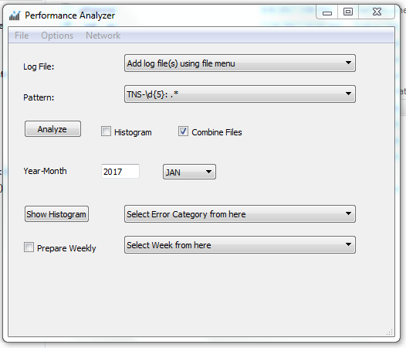
Automated Log Analyzer

Slide 4
Automated Log Analyzer
The Project involves searching for error patterns inside oracle alert logs and make sensible information out of them like their frequencies and histograms displayed as charts.
GUI based mode for easy to use and self-explanatory functioning.
Automatic/Script based mode for batch processing.
Capability to handle several logs and several patterns of errors.
Frequency histograms of errors found in Bar Chart based formats.
Automatic mailing of the output charts at every specified duration

Slide 5
Automated Log Analyzer - Contribution
The tool was developed from scratch by just me and no major code was used from anywhere else.
The tool expects a log file and a parameter file if you want to run it into batch mode for some reason.

Slide 6
Automated Log Analyzer – Future Planning
The tool is ready to be deployed on a centralized server to collect logs from various sources, analyze them and shoot mails on a pre-defined manner.
The idea has been submitted and as soon as the community approves, this project might be deployed.

Slide 7
JDA Server Manager
A unified web interface for managing JDA server out there in the cloud remotely while also keeping track of the servers relative to the customer they belong to.
It has capabilities to allow people to act as users and being to log in and have certain permissions.
Authorized users can manage servers i.e start and stop services and also grab performance related information like Disk free, Ram Usage and CPU Utilization.

Slide 8
JDA Server Manager - Contribution
Shared this project with Nikhar (a fellow friend) but most of it was my contribution.
I used the Django’s existing admin interface for management and rest of it was self-effort.

Slide 9
JDA Server Manager – Future Planning
As of now the interface has the sole ability to filter servers by customers and being able to manage just the details of the servers and customer. The real challenge left is to fetch information from the servers like RAM Usage, etc. and the ability to monitor services running on remote servers. Once all this is done, the project should be ready to get deployed.

Slide 10
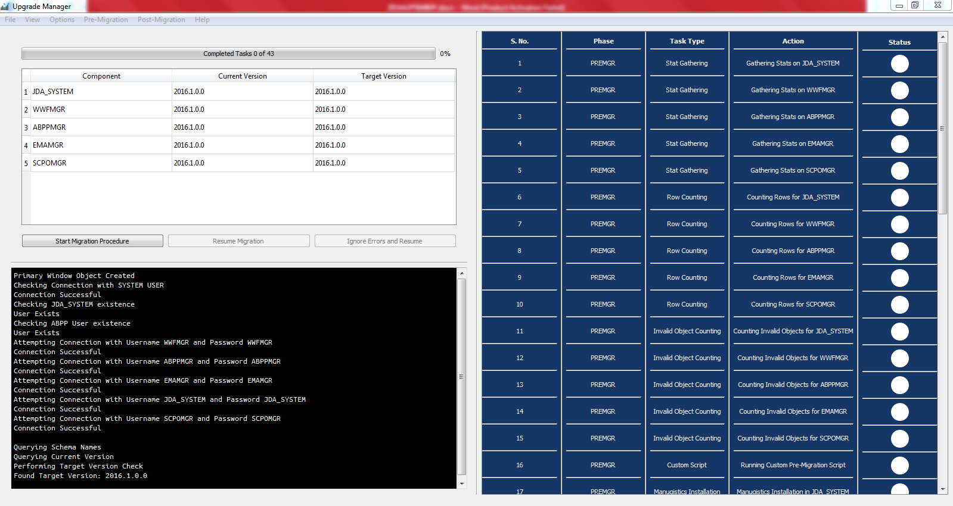
Upgrade Manager

Slide 11
Upgrade Manager
A tool to automate the procedure of performing migration of database pertaining to JDA application.
It is fully automatic and includes all steps mentioned in the official guide.
It has a user friendly GUI interface which looks very professional.
Tools used to build it were Python and PyQt5 which are free for commercial use.
It has capabilities to handle error situations and let the user effectively solve them.

Slide 12
Upgrade Manager - Contribution
The tool was built from scratch but it uses the scripts for migration that are provided with the JDA application.
It’s total completion time is around 2 months and it has over 2000 lines of code already.

Slide 13
Upgrade Manager – Future Planning
This is the biggest project among the others and scope is quite vast. Migration involves many components and it will take quite some time to include all of them but on the other hand reward is huge in terms of reducing the time and manpower it takes for migration activities. This Project was demonstrated to some top managers of JDA and they seemed very impressed with the work.

Slide 14
Learning
Words not enough to describe the skills learned.
Similar application can be built way faster.
Very comfortable with Python now.
Knowledge of functioning of JDA application.
Experience of Work in Corporate Environment.

